Slide 1
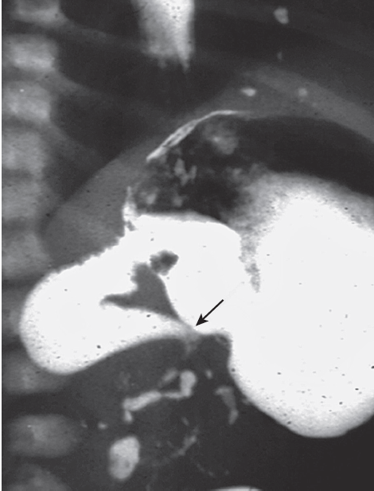
MALROTATION & MIDGUT VOLVULUS
PRESENTER; DR.YESHIGETA (PSR3)
MODERATOR; DR.WUBEDIL (GENERAL PEDIATRIC SURGEON)
march, 2019

Slide 2
Presentation outline
1. Introduction
2. Embryology review
3. Types of Malrotation
4. Clinical presentation
5. Associated anomalies
6. Diagnosis
7. Managements
8. Special consideration

Slide 3
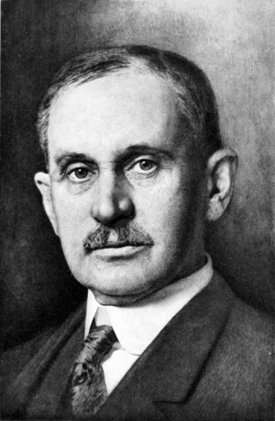
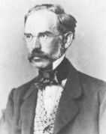
1. Introduction
MALL Treitz Ladd
Malrotation; abnormality of intestinal position & attachment
Due to errors during embryologic development
Common condition
  1:6000 ; clinically symptomatic
  1: 500 ; on imaging
  1: 100 ; autopsy study
Franklin Mall (1898) ; describe embryology meaningfully
Vaclav Treitz & William Ladd; describe small bowel anatomy & malrotation
William Ladd; father of pediatric surgery, Ladd’s procedure

Slide 4
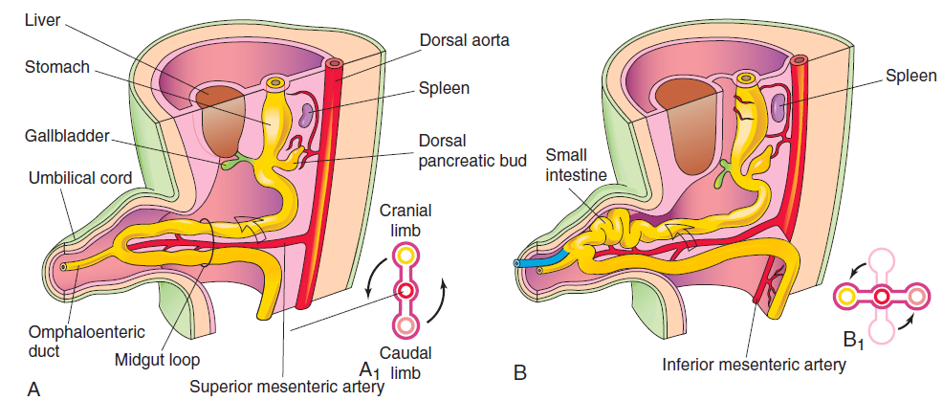
2. Embryology review
In malrotation; incorrect rotation & fixation of midgut
Midgut ; primitive gut supplied by SMA
U-shaped loop around SMA
  Prearterial / doudenojejunal loop
  Postarterial / cecocolic loop
Midgut rotate counter clockwise – 270⁰
Physiologic herniation – 6th week
1st step of rotation of prearterial limb

Slide 5
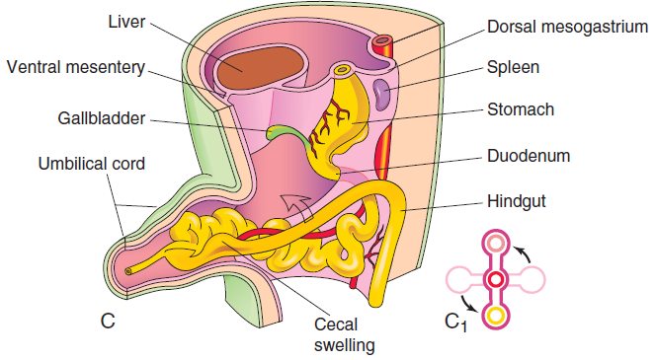
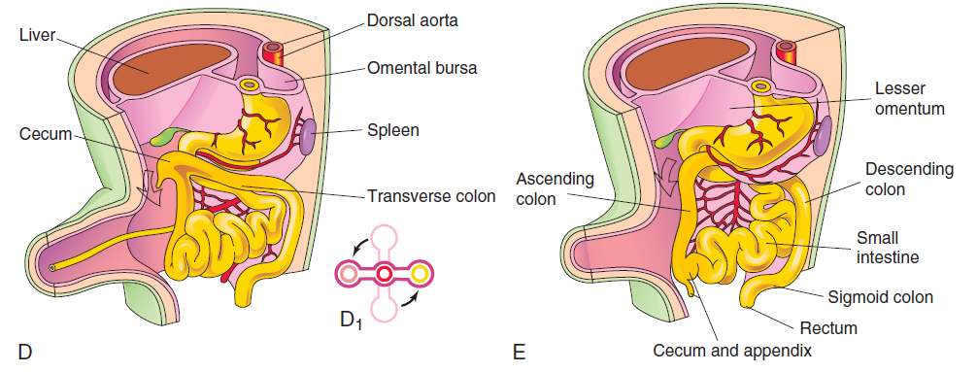
Embryology …cont’d
Video
10th wk; retraction (1st cephalic loop) , subsequent rotations & 11-12th wk; fixation

Slide 6
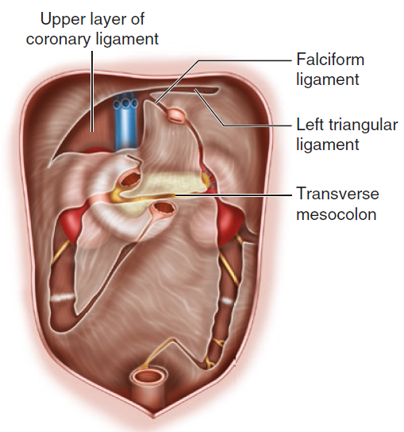
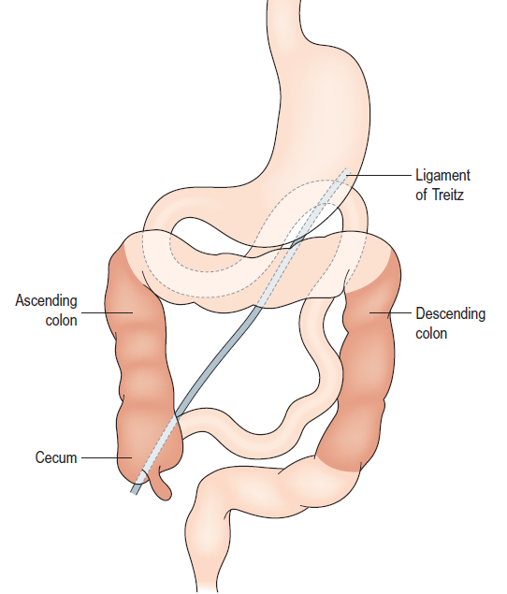
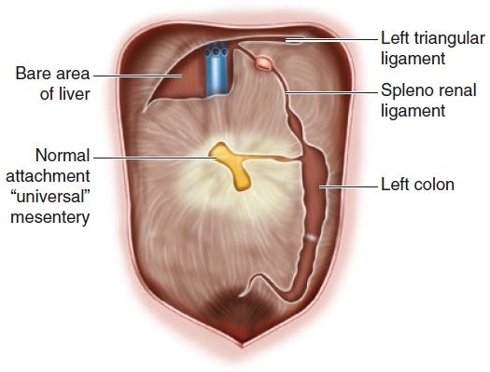
Embryology …cont’d
DJJ at LUQ
Cecum at RLQ
Wide root of mesentery
Duodenum, colon fixed

Slide 7
3. Classification of Malrotation
Non rotation
__________________
2. Incomplete / mixed rotation
  typical
  atypical
___________________
3. Reverse rotation
Misnomer (arrest at 90⁰ rotation)
Midgut Volvulus is less common
Arrest between 90⁰ and 270⁰ rotation
Associated with midgut volvulus
Malrotation
90⁰ clockwise rotation
Transverse colon may be obstructed

Slide 8
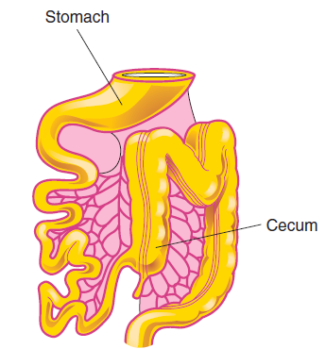
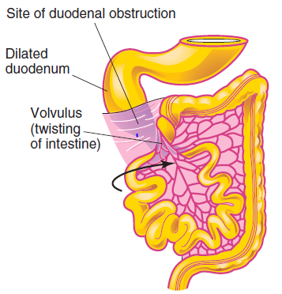
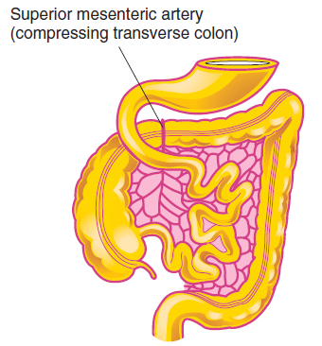
Classification …cont’d
Nonrotation incomplete and volvulus Reversed rotation

Slide 9
4. Clinical Presentations
asymptomatic
*midgut volvulus
MALROTATION
internal hernia
congenital band obstruction
colonic obstruction by SMA

Slide 10
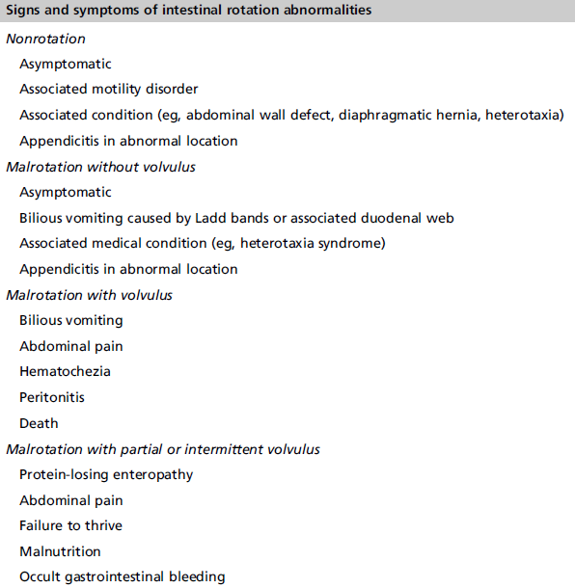

Slide 11
Malrotation with midgut volvulus
Bilious vomiting is surgical abdomen until proven otherwise!!
Acute | Chronic
Predisposing factors;( narrow base, long mesentery, bands) Inciting events; unknown Sudden onset bilious vomiting 90% present in first year of life Variable clinical symptoms & sign Urgent intervention | Intermittent or partial obstruction In older children >2 years Variable presentation ( vomiting, abdominal pain, bowel habit change) Malnutrition
Midgut volvulus with out presence of malrotation?

Slide 12
Duodenal obstruction
Acute duodenal obstruction
  3rd part of duodenum by extrinsic compression Ladd’s band
  Forceful bilious vomiting
  In neonate may have associated intrinsic obstruction
Chronic duodenal obstruction
  When prearterial rotation is not complete and fixed by abnormal band which cause intermittent kinking
  Poor weght gain, interminent abdominal cramp

Slide 13
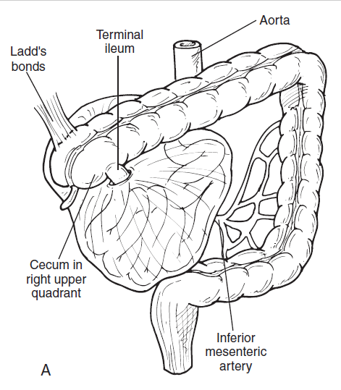
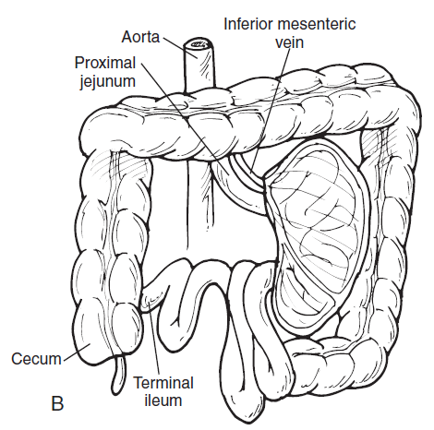
Internal hernia
A. Right mesocolic hernia
B. Left mesocolic hernia
How it occur?
Clinical features & diagnosis

Slide 14
Other clinical manifestations
Colonic obstruction;
  Reverse rotation
  Usually seen in adults
Volvulus of cecum
  Abnormal attachment
  In old age >60 years
Asymptomatic; identified on imaging or during operation for other conditions

Slide 15
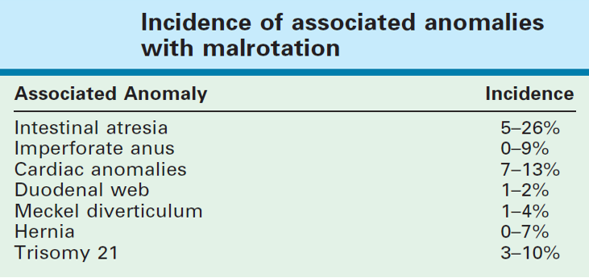
5. Associated anomalies

Slide 16
6. Diagnosis
Clinical: high index of suspicion
Laboratory: non specific & no diagnostic lab to recommend
Imaging: different options of imagings
  Plain AXR
  UGCS
  Ultrasound
  Barium enema
  CT/MRI
Exploration

Slide 17
Diagnosis …cont’d
Normal findings
Gasless abdomen with double bubble sign
Whole bowel distended
Pneumatosis intestinalis or pneumoperitonium
Plain AXR

Slide 18
Gold standard in diagnosis of malrotation (sen. 96%), midgut volvulus (sen. 79%)
beak sign , corkscrew sign, twisted Ribbon sign..
Equivocal features (25%)
UGCS

Slide 19

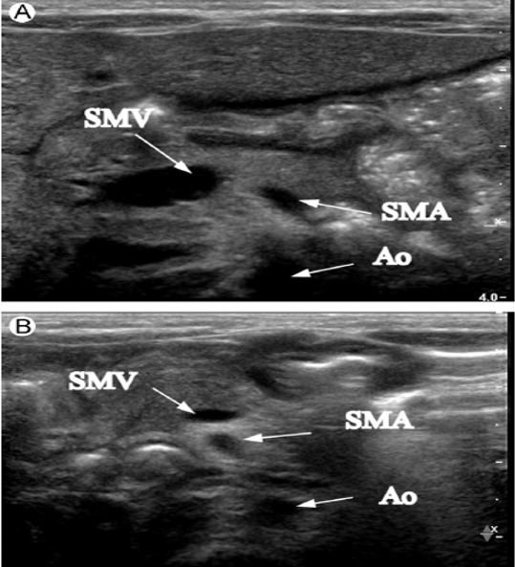
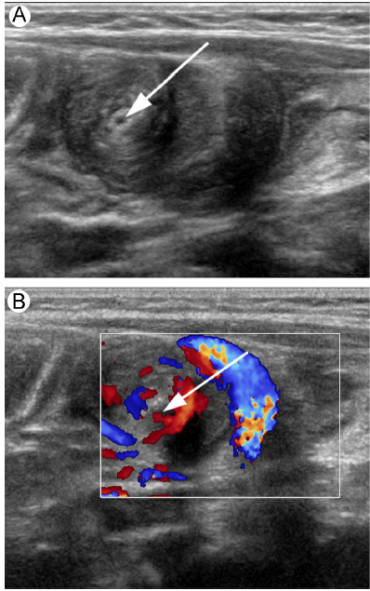
Relative position of SMV/SMA
Relative position of duodenum and SMA
Duodenal dilatation and tapering by water instillation
Mesenteric whirlpool sign
* Prenatal
Sen and Spe 89% & 92% in detecting volvulus
USG

Slide 20
Diagnosis …cont’d
When UGCS is equivocal
To see position of cecum & estimate distance between DJJ and cecum
Contrast Enema
Position of small bowel , large bowel and cecum
SMA/SMV relation
Presence of retroperitoneal duodenum
CT/
MRI
Exploration
Laparoscopic to evaluate mesenteric base width

Slide 21
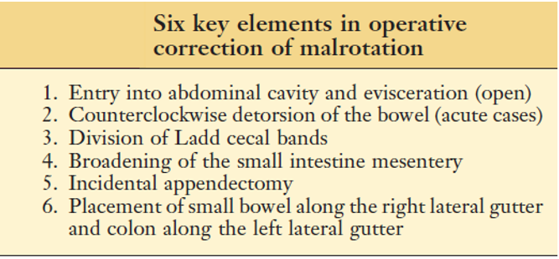
7. Management
Ladd's procedure
  Open or Laparoscopic

Slide 22
Mgt …cont’d
Preoperative; (not > than 1-2 hours)
  Stabilize patient and prepare for surgery
  Keep NPO
  IV fluid with isotonic fluid
  Electrolyte correction
  Correct hypothermia
  Gastric decompression
  Monitor urine output and hemodynamics

Slide 23
Mgt …cont’d (open Ladd’s )
Incision
Evisceration
Examination

Slide 24
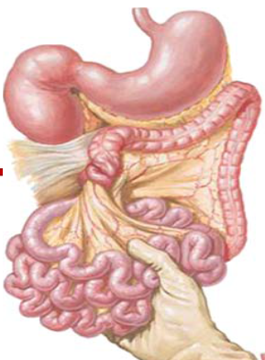
Mgt …cont’d (open Ladd’s )
Detorsion (counterclockwise)
Warm packing
Excision of gangrenous
Planning re-laparotomy

Slide 25
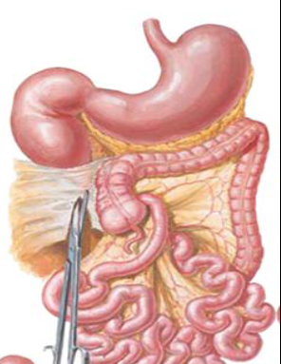
Mgt …cont’d (open Ladd’s )
Band release

Slide 26
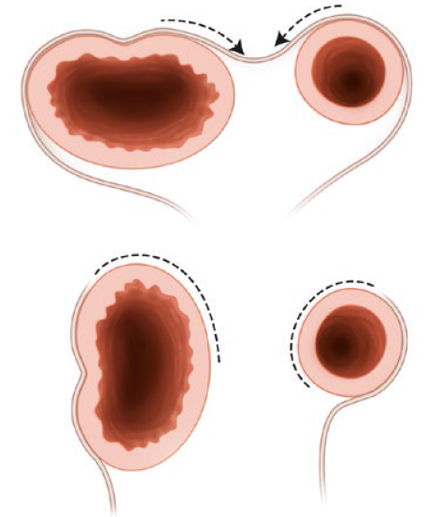
Mgt …cont’d (open Ladd’s )
Mesenteric widening
Straightening duodenum by dividing ligment of Tretz
Checking duodenal patency

Slide 27
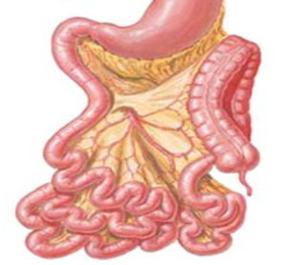
Mgt …cont’d (open Ladd’s )
Appendectomy
Replacing bowel

Slide 28
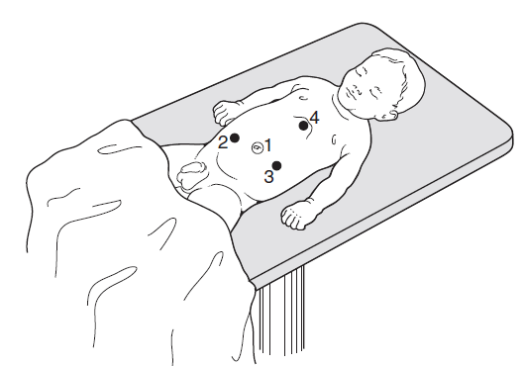
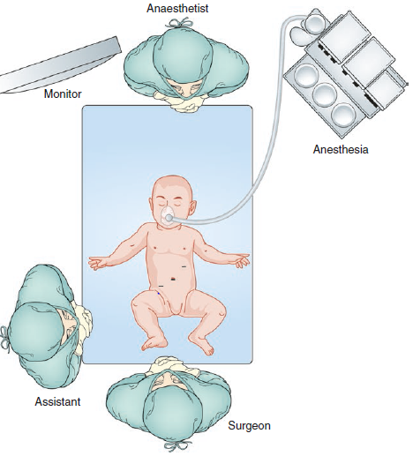
Mgt …cont’d (laparoscopic Ladd’s )
Laparoscopy in malrotation
  For Exploration
  Benefits
    Low hospital stay
    Early feeding
    Low infection
    Low adhesion ???

Slide 29
Mgt …cont’d
Post operative care;
  No NG tube if no volvulus
  Continue NG aspiration, IV fluid and electrolye support until bowel function return (1-5 days)
  Post op Antibiotics not required
  Parenteral nutrition if massive bowel lost until it adapt or plan for transplantation

Slide 30
Mgt …cont’d
Manage post operative complications
  Postoperative intussusception ( 3.1%)
  Recurrent volvulus low 1% (5% post laparoscopic & 0.5 % post open Ladd’s procedure)
  Adhesive small bowel obstruction (up to 10%)
  Short bowel syndrome if bowel loss …

Slide 31
8. Special considerations
Older children;
  If symptomatic ; operative correction
  If asymptomatic ; controversial
Atypical Malrotation;
  Equivocal imaging with symptoms
  Controversial to decide to operate
  Follow up with UGCS vs Laparoscopic Ladd’s procedure are options

Slide 32
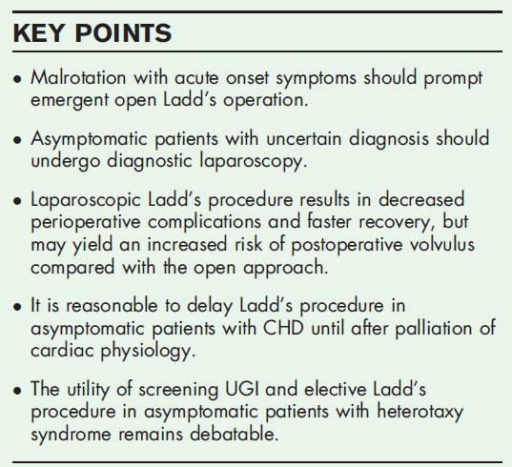
Special …cont’d
Heterotaxy syndrome;
  Screening done due to high incidence in such group
  If symptomatic ; operation
  If asymptomatic ; controversial because high post operative mortality.
  Risk of volvulus reaches to 27 %
  No strong evidence to recommend currently
Appendectomy if found in abnormal place? Ladd’s procedure if narrow base

Slide 33
References
Moore The developing human clinically oriented embryology 10th ed.
Coran pediatric surgery 7th ed.
Ashcraft pediatric surgery 6th ed.
Puri newborn surgery 4th ed.
Rickham’s neonatal surgery
Literatures..

Slide 34

Thank you

