Slide 1

Management of Newborn with EA/TEF
PRESENTER; DR.YESHIGETA H.
PSR-III
MODERATOR; DR. FISSEHA
CONSULTANT GENERAL PEDIATRIC SURGEON

Slide 2
Outlines
Introduction
Embryologic basis
Classifications
Associated anomalies
Diagnosis
Managements
Complications
Outcomes
Summary & pitfalls
References

Slide 3
1. Introduction …(history)
Thomas Gibson (1697); initial description
Leven and Ladd (1939); staged esophageal repair
Cameron Haight (1940); first successful primary repair
1980s pediatric surgery units in the developed world; survival 85-90%
In 2000; first successful thoracosopic repair

Slide 4
1. Introduction …(epidemiology)
Incidence; 1: 2500-4500 life births
M:F ratio is ~1.26:1
Recurrence risk;
One affected child - 0.5–2.0%
Two affected children – 20%
Vertical risk - 3–4%
Etiology is multifactorial
(genetic + environmental)
Neonatal GI Surgical emergency admission in TASH (1997-2001)
EA/TEF = 20%
Pattern & outcome of neonatal surgical cases in TASH (2010-2014)
EA/TEF= 12.6%
Pediatric surgical admission & procedures in TASH (2012-2017)
6th common congenital anomaly
11th common admission

Slide 5
1. Introduction …cont’d(epidemiology)
Risk factors;
Twin pregnancy (RR: 2.56)
White race (>60% risky than non-white)
Drugs (thalidomide, progesterone and estrogens, methimazole)
First pregnancy
Maternal diabetes
Increasing maternal age ??
in vitro fertilization patients

Slide 6
2. Embryology
4th Week; ventral respiratory & dorsal esophageal part
7th Week; tracheoesophageal septum; separate the two parts
Lateral tracheoesophageal folds
Cranial – caudal folds

Slide 7
2. Embryology …cont’d (pathogenesis)
Theories of EA/TEF
Failure of recanalization (historical)
Failure of lateral tracheoesophageal folds to meet at mid line
Cranial and caudal folds growth imbalance
Ectopic expression of sonic hedgehog between the notochord and the gut
Imbalance between the BMP and Nog( BMP antagonist)
EA is a component of cephalic neurocristopathy

Slide 8
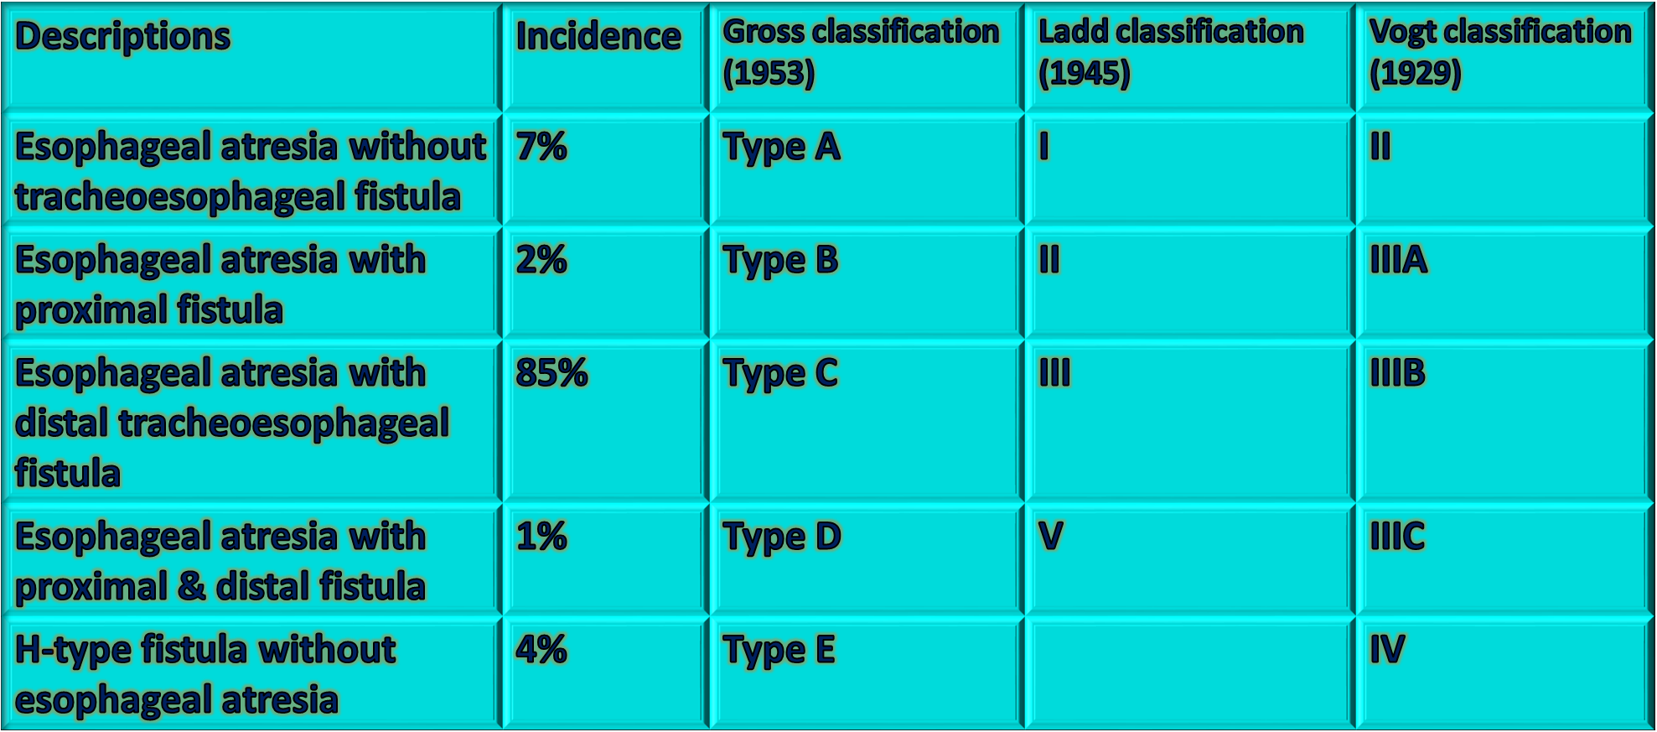
3. Classifications …(morphologic)
Type F

Slide 9
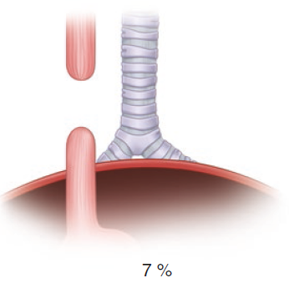
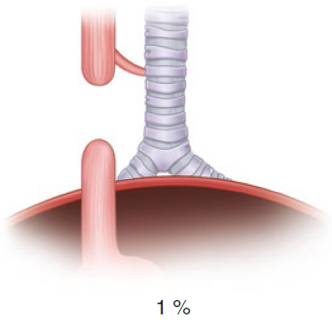
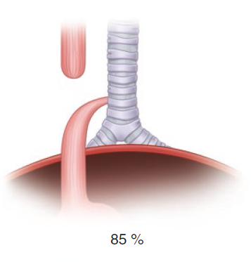
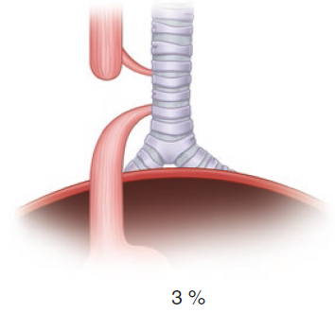
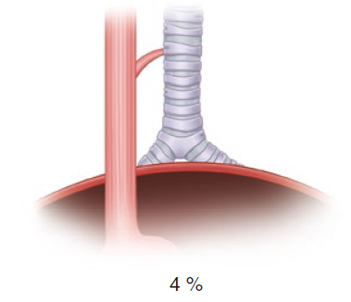
3. Classifications …cont’d(…morphologic)
Level of azygus
Short pouch
End vs fistula
Fistula orientation
T3-4 level
In 1-2cm carina
Rare
No. prox. fistula
N-type (no atresia)
Thoracic inlet
Notes:
.

Slide 10
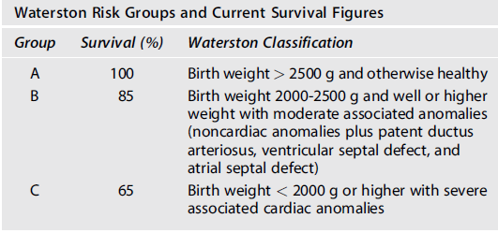
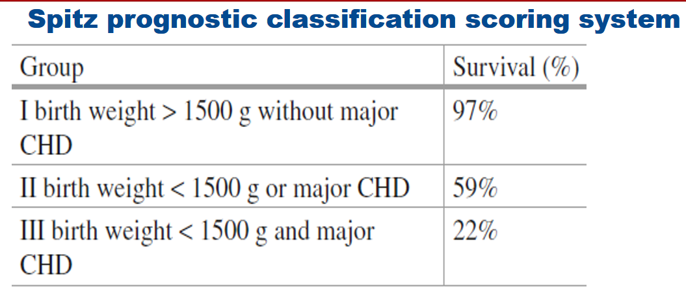
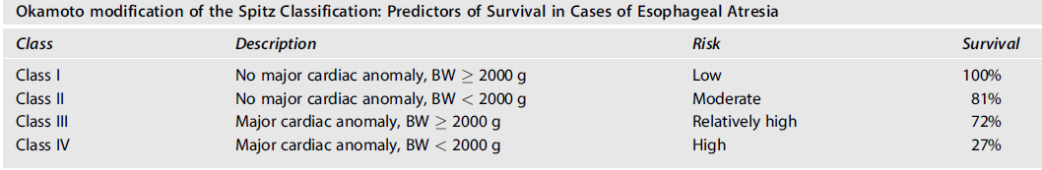
3. Classifications …cont’d (risk)

Slide 11
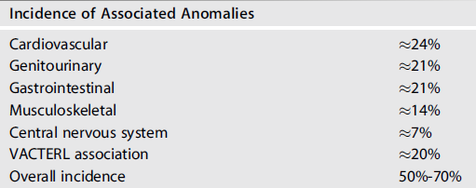
4. Associated anomalies
Two forms;
Isolated EA/TEF - 50%
Syndromic EA/TEF - 50%
Death in EA with CHD; RR-3.47

Slide 12
5. Diagnosis EA/TEF
Antenatal;
Aim;
Decide place of delivery
Counseling termination if associated chromosomal anomalies
Prevent inadvertent feeding & aspiration pneumonia
Modalities;
Ultrasound ( pouch sign, polyhydramnios, absence of stomach)
Detection rate <20%
MRI ( non visualization of thoracic esophagus)
Sensitivity 60-100%

Slide 13
5. Diagnosis EA/TEF… cont’d
Postnatal;
NG tube + X-ray
History of polyhydramnios
Any anomaly that fit in to VACTERL
Presentations
Excess salivation
Cough, chocking, cyanosis and respiratory distress worsened by feeding

Slide 14
5. Diagnosis EA/TEF… cont’d
X-Ray;
Chest & abdomen /NGT
Findings
Coiled NGT
Gas below diaphragm
Double bubble sign
Gasless, featureless
Rib & Vertebral anomaly

Slide 15
5. Diagnosis EA/TEF… cont’d
Gap (in vertebra No.);
<2: primary
2-6: delayed
>6: replacement
Associated anomalies
Other GI, GU and vertebral anomalies
Cardiac evaluation
Cardiac anomalies
Laterality of aortic arch (echo accuracy is 20%, MRI is diagnostic)
Gap estimation (usually not known pre-op)
Pure EA; mostly long gap (clinical)
Thoracoscopic exploration
Pre-op rigid bronchoscopy (site, size of fistula)
If gastrostomy done;
Gastroscopy , contrast study,

Slide 16
6. Managements …(pre-operative care)
Essential neonatal care
Correct and early diagnosis
Prevention of aspiration pneumonitis & atelectasis
head up prone position, continuous suctioning , oxygen support, broad spectrum antibiotics, antacid , chest physiotherapy
IV line and blood sample (Ix & cross match)
Sever respiratory distress, intubation & low pressure ventilation
Vitamin K analog should be given

Slide 17
6. Managements …cont’d (pre-operative care)
Gastric distention with respiratory worsening
Emergency fistula ligation – ( definitive repair in 7-14 days)
Thoracoscopic
Trans-pleural
Gastrostomy ( for extremely unstable)
Under water seal
Occlusion of fistula with Foley catheter balloon
Other (temperature, glycemic and fluid monitoring & managements)

Slide 18
6. Managements …(operative care)
Height of neonatal surgical care
Best done in first 24 hrs
Better done on working hrs (time to comfirm diagnosis & associated anomalies)
Approaches
Open thoracotomy
Thoracoscopy
Scenarios;
EA with distal TEF (short gap)
Pure EA or long gap EA/TEF
H-type TEF or Proximal fistula

Slide 19
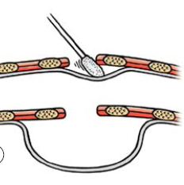
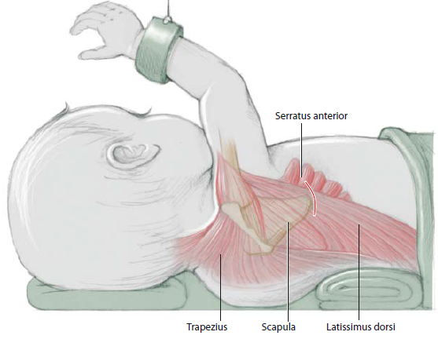
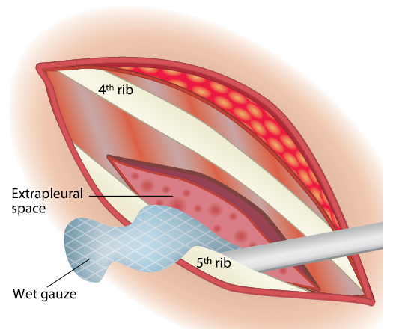
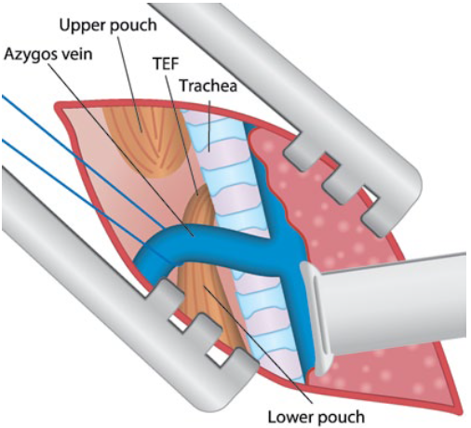
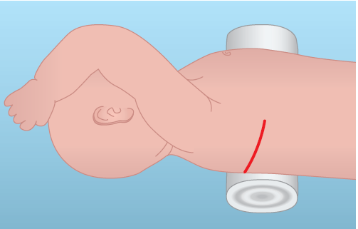
6. Managements …cont’d (operative care)
Azygus ligation
Mediastinal over compression
For EA with distal TEF
Muscle sparing
Opposite side of aortic arch

Slide 20
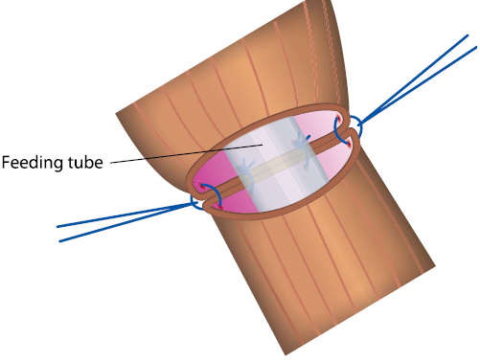
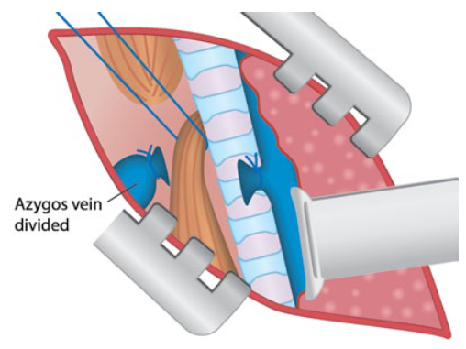
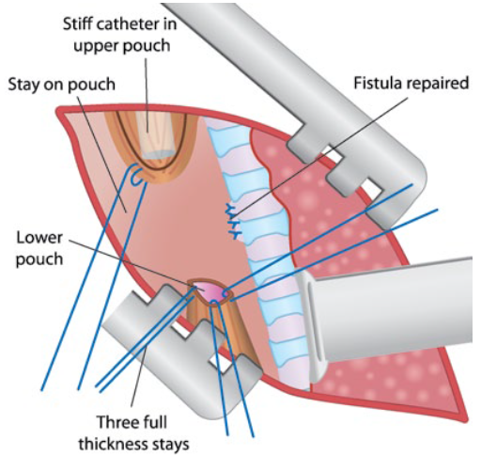
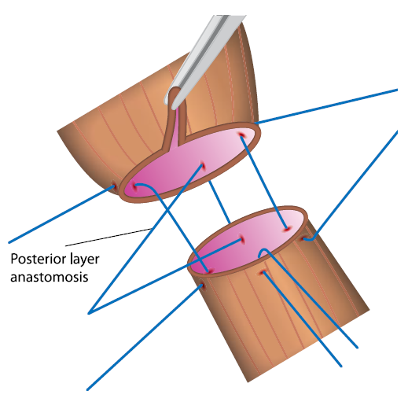
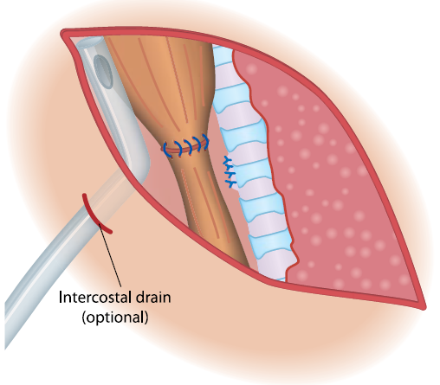
6. Managements …cont’d (operative care)
TAT tube
Drainage tube
Absorbable suture
Air tightness
Full thickness
…cont’d

Slide 21
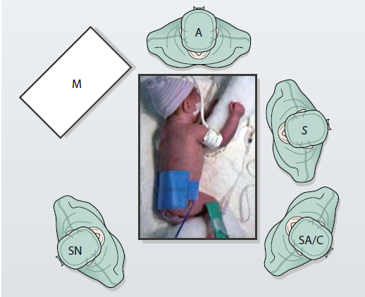
6. Managements …cont’d (operative care)
Thoracoscopy
Less musculoskeletal sequel
Improved visualization
Less extensive dissection

Slide 22
6. Managements …cont’d (operative care)
For pure EA
Initial management – gastrostomy + bronchoscopy
Followed by
Delayed primary repair or
Esophageal replacements
Long gap expected ( gap estimation)
EA with out distal fistula has high risk of having proximal fistula
Contrast study
Bronchoscopy

Slide 23
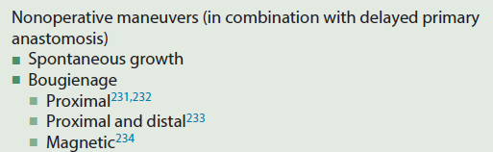
6. Managements …cont’d (operative care)

Slide 24
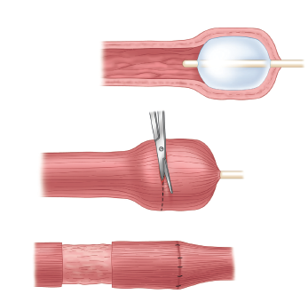
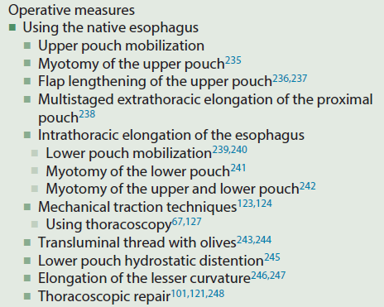
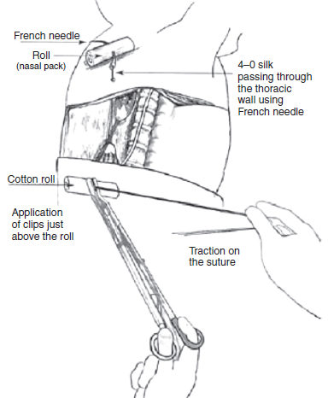
6. Managements …cont’d (operative care)

Slide 25
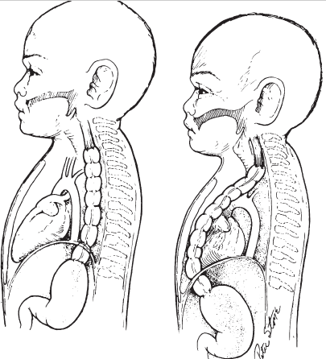
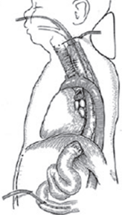
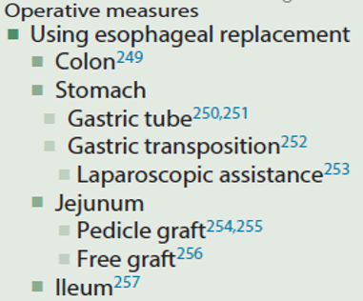
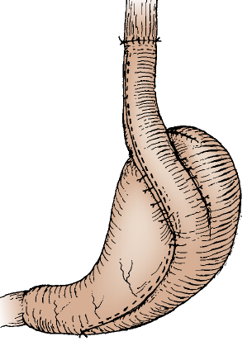
6. Managements …cont’d (operative care)

Slide 26
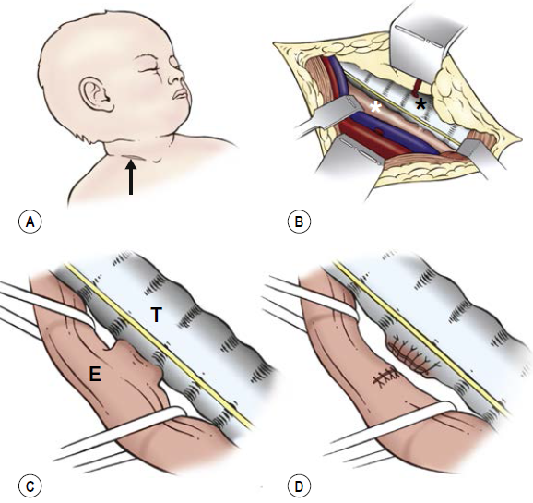
6. Managements …cont’d (operative care)
H-type fistula management
For missed upper pouch TEF

Slide 27
6. Managements …cont’d (intra-operative care)
Monitoring and managements
Oxygen Saturation
Temperature (insulation )
ET CO2
Fluid status and electrolytes
Glycemic control

Slide 28
6. Managements …cont’d (post-operative care)
Nursing at ICU
Elective paralysis (3-5 days)
Post op anti acid
Esophagogram at 5-7 days
TAT feeding after 48 hrs
Temperature monitoring
Fluid managements
Adequate analgesia

Slide 29
7. Complications
Predictors of complications
Preoperative intubation
Birth weight less than 2500 g
Long-gap atresia
Anastomotic leak
Twin birth
Postoperative intubation longer than 4 days
Inability to feed at the end of 1 month

Slide 30
Complications
Complications | Descriptions
Anastomotic leak: | No uniform definition Rate 3.5-17% (major leak 3.5%) ( thoracoscopic 7.6%)
Anastomotic stricture : | Definition is not uniform ( 50% decrease in lumen or symptom + narrowing detected on esophagoscopy or esophagogram) Incidence is 17–60%
Recurrent TEF: | Incidence is 3-15% ( thoracscopic 1.9%) Etiology is mainly anastomotic leak
Disorder of peristalsis | Congenital vs acquired
Gastroesophageal reflux | Incidence up to 50%
Esophageal carcinoma | Weather to screen adults is debatable
Vocal cord paralysis | Incidence is 12-50% Weather congenital or during repair
Respiratory morbidities
Thoracotomy related morbidities | Incidence >50% Include winged scapula, asymmetry of the chest wall, rib fusion, scoliosis, and breast and pectoral muscle maldevelopment
Tracheomalasia | Local or generalized weakness of trachea that leads to the colipase of tracheal wall during expiration

Slide 31
8. Outcomes
Currently survival is >95%
Survival used to be <40% before the 1950s
Outcome predictors;
Gap lengths
Major CHD
Birth weight / prematurity
Pulmonary comorbidity requiring ventilator support
Sever associated anomalies
Neonatal GI Surgical emergency admission in TASH (1997-2001)
EA/TEF = 20%
1/12 (8.3%) discharged alive
Pattern & outcome of neonatal surgical cases in TASH (2010-2014)
EA/TEF mortality 73.2% (60/82)
Assessment of outcome of neonate with EA/TEF in TASH (2008-2013)
5/34 (14.7%) discharged alive

Slide 32
9. Summary & pitfalls
Survival from EA/TEF in developed country is high
Perioperative care is critical in EA/TEF management
Pitfalls in our settings;
Aspiration prevention (?? Suctioning frequency & technique)
Infection prevention
Hypothermia and fluid and electrolyte management
Nutritional support
Delayed presentation
Un recognized associated anomalies
Anesthesia and NICU care etc

Slide 33
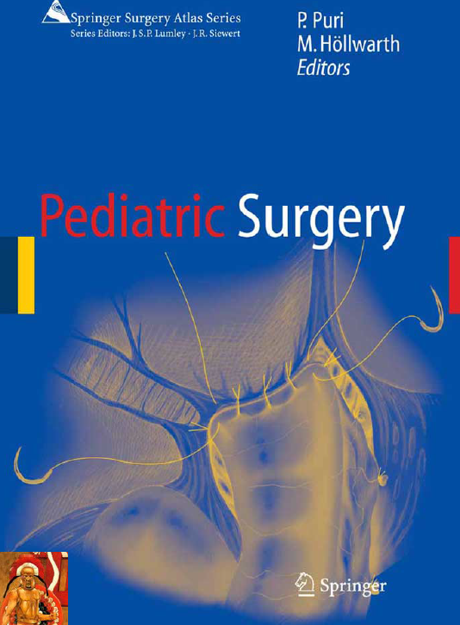
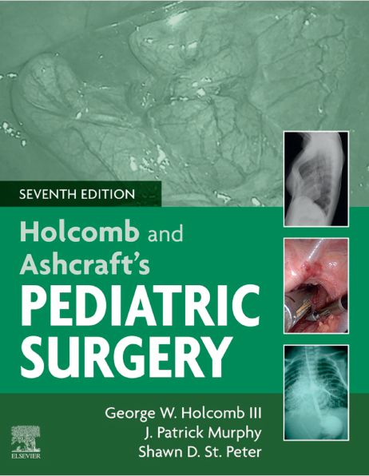
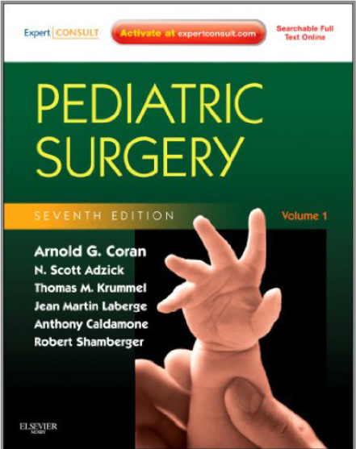
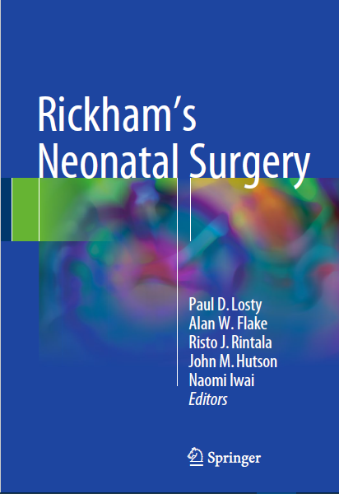
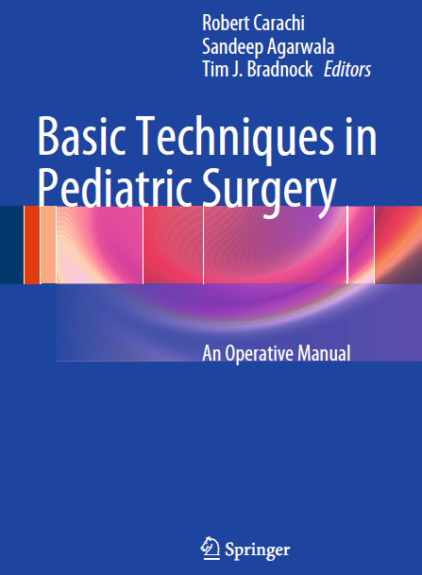
10. References

Slide 34
Thank you

